Slide 1

Statistical Analysis of Monthly Air Passengers
(1949-1960)
STAT 3124
Time Series Analysis
Group P
192055 – g.a.m.k. jayathilaka
192059 – T.n.d. kodippily
192126 – w.l.t. sankalpani
192135 – m.a.s. shavindi

Slide 2

Introduction
Data set was obtained by Kaggle website
This is a study of performing statistical analysis on the number of monthly air passengers
1949 - 1960
  Properties of the data are described using Box – Jenkin’s Methodology & Minitab to analyse the series.

Slide 3
Dataset
 | 1949 | 1950 | 1951 | 1952 | 1953 | 1954 | 1955 | 1956 | 1957 | 1958 | 1959 | 1960
January | 112 | 115 | 145 | 171 | 196 | 204 | 242 | 284 | 315 | 340 | 360 | 417
February | 118 | 126 | 150 | 180 | 196 | 188 | 233 | 277 | 301 | 318 | 342 | 391
March | 132 | 141 | 178 | 193 | 236 | 235 | 267 | 317 | 356 | 362 | 406 | 419
April | 129 | 135 | 163 | 181 | 235 | 227 | 269 | 313 | 348 | 348 | 396 | 461
May | 121 | 125 | 172 | 183 | 229 | 234 | 270 | 318 | 355 | 363 | 420 | 472
June | 135 | 149 | 178 | 218 | 243 | 264 | 315 | 374 | 422 | 435 | 472 | 535
July | 148 | 170 | 199 | 230 | 264 | 302 | 364 | 413 | 465 | 491 | 548 | 622
August | 148 | 170 | 199 | 242 | 272 | 293 | 347 | 405 | 467 | 505 | 559 | 606
September | 136 | 158 | 184 | 209 | 237 | 259 | 312 | 355 | 404 | 404 | 463 | 508
October | 119 | 133 | 162 | 191 | 211 | 229 | 274 | 306 | 347 | 359 | 407 | 461
November | 104 | 114 | 146 | 172 | 180 | 203 | 237 | 271 | 305 | 310 | 362 | 390
December | 118 | 140 | 166 | 194 | 201 | 229 | 278 | 306 | 336 | 337 | 405 | 432

Slide 4
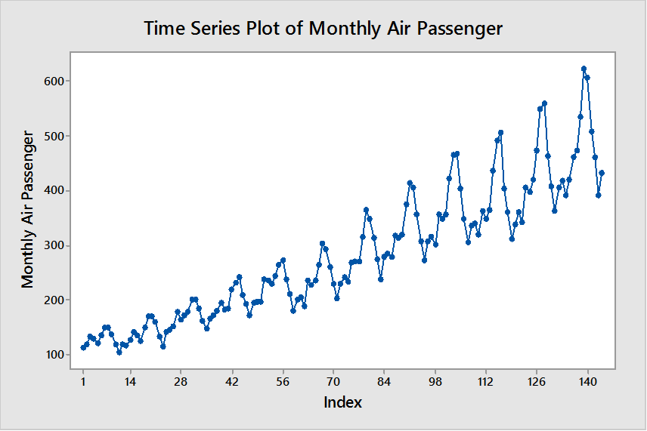
Time Series Plot of Monthly Air Passengers
Upward Trend
Increasing Seasonal Variation With Lag 12

Slide 5
Multiplicative Decomposition
Period | Index
January | 0.909268
February | 0.874866
March | 0.996728
April | 0.974048
May | 0.981221
June | 1.114614
July | 1.254857
August | 1.208643
September | 1.059133
October | 0.92322
November | 0.802955
December | 0.900446
$$Y_{t}=88.42+2.6447×t$$

Slide 6
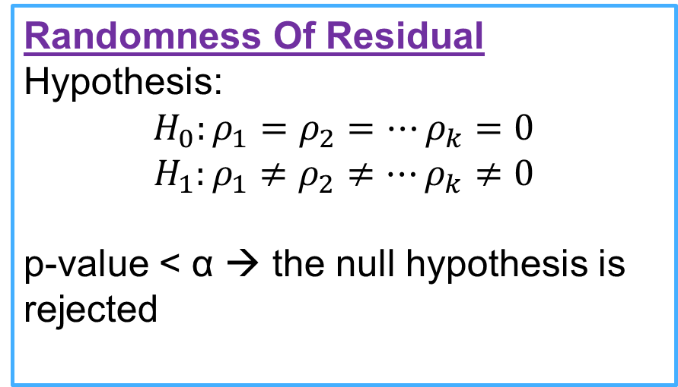
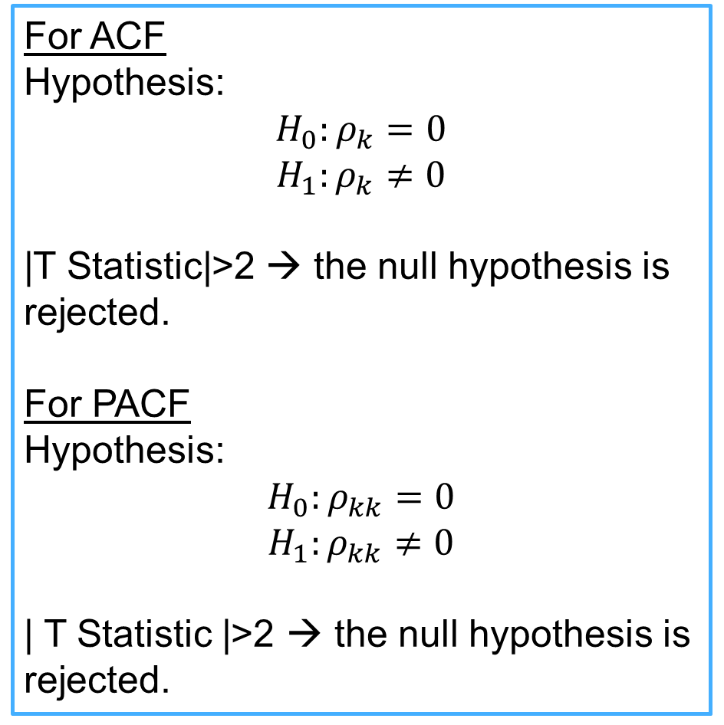
Hypothesis used:
Significance Of Parameter
Hypothesis:
H₀: Constant = 0 vs H₁: Not so
H’₀: Coefficient = 0 vs H’₁: Not so
p-value < α → the null hypothesis is rejected
For ACF
Hypothesis:
$$H_{0}:ρ_{k}=0$$
$$H_{1}:ρ_{k}≠0$$
|T Statistic|>2 → the null hypothesis is rejected.
For PACF
Hypothesis:
$$H_{0}:ρ_{kk}=0$$
$$H_{1}:ρ_{kk}≠0$$
| T Statistic |>2 → the null hypothesis is rejected.
Randomness Of Residual
Hypothesis:
$$H_{0}:ρ_{1}=ρ_{2}=…ρ_{k}=0$$
$$H_{1}:ρ_{1}≠ρ_{2}≠…ρ_{k}≠0$$
p-value < α → the null hypothesis is rejected

Slide 7
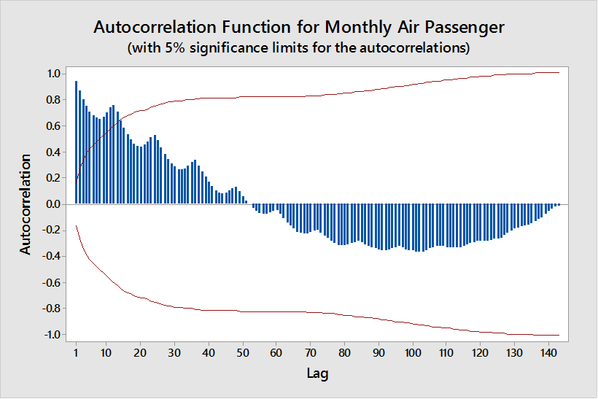
Autocorrelation Function of Monthly Air Passengers
Dies Down Slowly
Non Stationary
Seasonal Pattern
Non Seasonal Difference

Slide 8
Autocorrelation Function of Non Seasonally Differenced Series
Non Stationary
Seasonal Pattern
Seasonal Difference

Slide 9
Autocorrelation Function of Seasonally differenced data:
Cuts Off At Non Seasonal Lag 1
 | lag | ACF | T Statistic | LBQ
Non Seasonal Area | 1 | -0.309814643 | -3.545990668 | 12.8642202
 | 2 | 0.095351458 | 0.999609289 | 14.09219062
 | 3 | -0.096890891 | -1.008087602 | 15.37003765
 | 4 | -0.098995034 | -1.022081511 | 16.7144919
 | 5 | 0.061000707 | 0.624843225 | 17.22903543
 | 6 | -0.000287806 | -0.002939312 | 17.22904698
 | 7 | -0.056108484 | -0.573025816 | 17.67138913
 | 8 | -0.060965772 | -0.621077605 | 18.19787895
 | 9 | 0.175916925 | 1.78686754 | 22.61743203
 | 10 | -0.14027891 | -1.391367506 | 25.45092626
 | 11 | 0.069735328 | 0.681675021 | 26.15699565
Seasonal Area | 12 | -0.133673434 | -1.302070668 | 28.77316701
 | 24 | 0.052836049 | 0.464327546 | 51.36242016
 | 36 | -0.018646436 | -0.158426106 | 61.1863815
 | 48 | -0.003842657 | -0.031658437 | 72.27584304
Stationary
0 At Seasonal Lags

Slide 10
Partial Autocorrelation Function of Stationary Series:
 | lag | PACF | T Statistic
Non Seasonal Area | 1 | -0.30982 | -3.54599
 | 2 | -0.0007 | -0.00802
 | 3 | -0.07472 | -0.85519
 | 4 | -0.16676 | -1.90866
 | 5 | -0.01515 | -0.17336
 | 6 | 0.018288 | 0.20931
 | 7 | -0.08809 | -1.00819
 | 8 | -0.13389 | -1.53241
 | 9 | 0.156405 | 1.79014
 | 10 | -0.05875 | -0.67242
 | 11 | -0.05243 | -0.60007
Seasonal Area | 12 | -0.11501 | -1.31638
 | 24 | 0.117491 | 1.34475
 | 36 | -0.0212 | -0.24268
 | 48 | 0.001826 | 0.0209
 | 60 | 0.012838 | 0.14694
Cuts Off At Non Seasonal Lag 1
0 at Seasonal Lags

Slide 11
p=1
P=0
D=1
d=1
q=1
Q=0
Tentative Model 01
SARIMA (1,1,1) (0,1,0)₁₂

Slide 12

Adequacy
Checking for
SARIMA (1,1,1) (0,1,0)₁₂

Slide 13
Estimates of Parameters SARIMA (1,1,1) (0,1,0)₁₂
Type | Coef | SE Coef | T | P
AR 1 | -0.3012 | 0.2765 | -1.09 | 0.278
MA 1 | 0.0100 | 0.2907 | 0.03 | 0.973
Constant | 0.230 | 1.024 | 0.22 | 0.822
Remove constant
Type | Coef | SE Coef | T | P
AR 1 | -0.3012 | 0.2752 | -1.11 | 0.269
MA 1 | 0.0052 | 0.2897 | 0.02 | 0.986
Not Significant
Not Significant
Remove MA
Significant
Modify the model
Modified Model 01
Type | Coef | SE Coef | T | P
AR 1 | -0.3099 | 0.0834 | -3.72 | 0.000
SARIMA (1,1,0) (0,1,0)₁₂

Slide 14
Randomness Of Residual:
SARIMA (1,1,0) (0,1,0)₁₂
ACF is 0
Modified Box-Pierce (Ljung-Box) Chi-Square statistic
Check ACF & PACF of residual
Lag | 12 | 24 | 36 | 48
Chi-square | 11.7 | 38.3 | 45.0 | 60.1
DF | 11 | 23 | 35 | 47
P-value | 0.385 | 0.024 | 0.120 | 0.096
Residuals Are Random
Residuals are not Random
PACF is 0

Slide 15
Parameter Redundancy SARIMA (1,1,0) (0,1,0)₁₂
Parameter Redundancy Does Not Exists
There is One Parameter
Normality Of Residuals SARIMA (1,1,0) (0,1,0)₁₂
Residuals Are Normally Distributed
Bell Shape
Straight Line Pattern
+
Outliers

Slide 16
✓
Significance of Parameters
✓
Randomness of Residuals
✗
Parameter Redundancy
✓
Normality of Residuals
SARIMA (1,1,0) (0,1,0)₁₂ is Adequate

Slide 17
Adequacy
Checking for
SARIMA (1,1,1) (0,1,0)₁₂

Slide 18
Estimates of Parameters SARIMA (1,1,1) (0,1,0)₁₂
Type | Coef | SE Coef | T | P
AR 1 | -0.3012 | 0.2765 | -1.09 | 0.278
MA 1 | 0.0100 | 0.2907 | 0.03 | 0.973
Constant | 0.230 | 1.024 | 0.22 | 0.822
Remove constant
Type | Coef | SE Coef | T | P
AR 1 | -0.30 | 0.2752 | -1.11 | 0.269
MA 1 | 0.0052 | 0.2897 | 0.02 | 0.986
Not Significant
Not Significant
Remove
AR
Significant
Modify the model
Modified Model 02
Type | Coef | SE Coef | T | P
MA 1 | 0.3212 | 0.0837 | 3.84 | 0.000
SARIMA (0,1,1) (0,1,0)₁₂

Slide 19
Randomness Of Residual
SARIMA (0,1,1) (0,1,0)₁₂
ACF is 0
Modified Box-Pierce (Ljung-Box) Chi-Square statistic
Check ACF & PACF of Residual
Lag | 12 | 24 | 36 | 48
Chi-square | 12.0 | 38.6 | 46.1 | 62.1
DF | 11 | 23 | 35 | 47
P-value | 0.367 | 0.022 | 0.099 | 0.069
Residuals Are Random
Residuals Are Not Random
PACF is 0

Slide 20
Parameter Redundancy SARIMA (0,1,1) (0,1,0)₁₂
Parameter Redundancy Does Not Exists
There is One Parameter
Normality Of Residuals SARIMA (0,1,1) (0,1,0)₁₂
Straight Line Pattern
+
Outliers
Residuals Are Normally Distributed
Bell Shape

Slide 21
✓
Significance of Parameters
✓
Randomness of Residuals
✗
Parameter Redundancy
✓
Normality of Residuals
SARIMA (0,1,1) (0,1,0)₁₂ is Adequate

Slide 22
Autocorrelation Function of Monthly Air Passengers
Non Stationary
Seasonal Pattern
Seasonal Difference

Slide 23
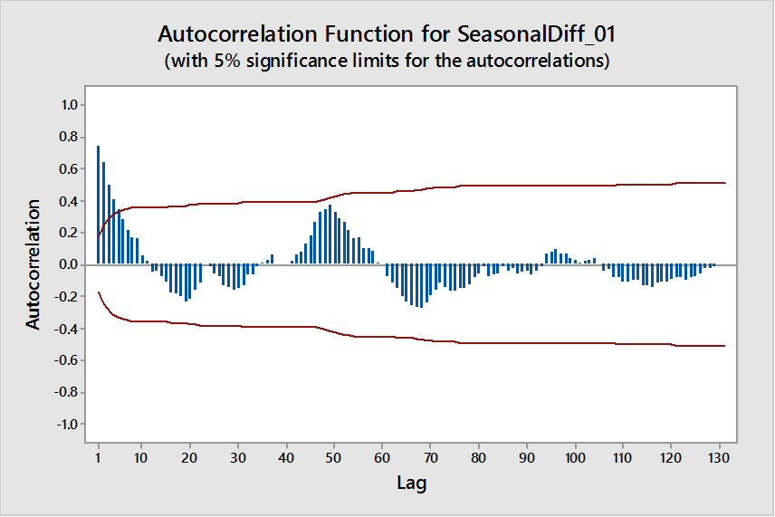
Autocorrelation Function of seasonally Differenced Series:
Dies Down Quickly At Non Seasonal Lag
 | lag | ACF | T Statistic | LBQ
Non Seasonal Area | 1 | 0.74646 | 8.57618 | 75.235
 | 2 | 0.647083 | 5.11273 | 132.206
 | 3 | 0.504892 | 3.37629 | 167.16
 | 4 | 0.40646 | 2.50993 | 189.989
 | 5 | 0.354782 | 2.09319 | 207.52
 | 6 | 0.283378 | 1.61903 | 218.793
 | 7 | 0.216276 | 1.21183 | 225.412
 | 8 | 0.175025 | 0.96996 | 229.782
 | 9 | 0.164732 | 0.90648 | 233.684
 | 10 | 0.057201 | 0.31282 | 234.159
 | 11 | 0.01907 | 0.10421 | 234.212
Seasonal Area | 12 | -0.043736 | -0.23899 | 234.494
 | 24 | -0.013841 | -0.07151 | 275.036
 | 36 | 0.033021 | 0.1667 | 295.398
 | 48 | 0.353707 | 1.70702 | 371.638
Stationary
0 At Seasonal Lags

Slide 24
Partial Autocorrelation Function of Stationary Series:
Cuts Off At Non Seasonal Lag 2
 | lag | PACF | T Statistic
Non Seasonal Area | 1 | 0.74646 | 8.57618
 | 2 | 0.202983 | 2.33209
 | 3 | -0.074439 | -0.85523
 | 4 | -0.014184 | -0.16296
 | 5 | 0.08005 | 0.91971
 | 6 | -0.030608 | -0.35166
 | 7 | -0.059 | -0.67786
 | 8 | 0.022455 | 0.25799
 | 9 | 0.077707 | 0.89279
 | 10 | -0.218328 | -2.5084
 | 11 | -0.020258 | -0.23275
Seasonal Area | 12 | -0.007385 | -0.08484
 | 24 | -0.123419 | -1.41798
 | 36 | -0.046152 | -0.53024
 | 48 | 0.040117 | 0.46091
0 At Seasonal Lags

Slide 25
p=2
P=0
D=1
d=0
q=0
Q=0
Tentative Model 02
SARIMA (2,0,0) (0,1,0)₁₂

Slide 26
Adequacy
Checking for
SARIMA (2,0,0) (0,1,0)₁₂

Slide 27
Estimates of Parameters SARIMA (2,0,0) (0,1,0)₁₂
Type | Coef | SE Coef | T | P
AR 1 | 0.6013 | 0.0859 | 7.00 | 0.000
MA 1 | 0.2164 | 0.0855 | 2.53 | 0.013
Constant | 0.5586 | 0.9895 | 5.62 | 0.000
Parameters Are Significant

Slide 28
Randomness Of Residual SARIMA (2,0,0) (0,1,0)₁₂
ACF is 0
Modified Box-Pierce (Ljung-Box) Chi-Square statistic
Check ACF & PACF of Residual
Residuals Are Random
Lag | 12 | 24 | 36 | 48
Chi-square | 9.7 | 33.9 | 41.6 | 54.6
DF | 9 | 21 | 33 | 45
P-value | 0.379 | 0.037 | 0.146 | 0.155
Residuals Are Not Random
PACF is 0

Slide 29
Parameter Redundancy SARIMA (2,0,0) (0,1,0)₁₂
Correlation matrix of the estimated parameters
Remove
AR
 | 1 | 2
2 | -0.760
3 | -0.032 | -0.013
SARIMA (1,0,0) (0,1,0)₁₂
Parameter Redundancy Exists
Estimates of Parameters SARIMA (1,0,0) (0,1,0)₁₂
Parameters Are
Significant
Type | Coef | SE Coef | T | P
AR 1 | 0.7625 | 0.569 | 13.39 | 0.000
Constant | 7.362 | 1.008 | 7.31 | 0.000

Slide 30
Randomness Of Residual SARIMA (1,0,0) (0,1,0)₁₂
Modified Box-Pierce (Ljung-Box) Chi-Square statistic
Cuts Off At Non Seasonal Lag 1
Lag | 12 | 24 | 36 | 48
Chi-square | 18.9 | 39.6 | 49.2 | 59.5
DF | 10 | 22 | 34 | 46
P-value | 0.041 | 0.012 | 0.044 | 0.087
 | lag | ACF | T Statistic | LBQ
Non Seasonal Area | 1 | -0.178650945 | -2.05254309 | 4.309412523
 | 2 | 0.161911463 | 1.803549109 | 7.876309544
 | 3 | -0.022399751 | -0.243582955 | 7.945107478
 | 4 | -0.038358819 | -0.416940244 | 8.14843643
 | 5 | 0.088735995 | 0.96324599 | 9.245103128
 | 6 | 0.029343549 | 0.316314118 | 9.365977284
 | 7 | -0.023380133 | -0.251839575 | 9.443327703
 | 8 | -0.033655845 | -0.362350551 | 9.604904144
 | 9 | 0.175972743 | 1.89270216 | 14.05802441
 | 10 | -0.118187895 | -1.23803346 | 16.0832103
 | 11 | 0.053468713 | 0.553699262 | 16.50112998
Seasonal Area | 12 | -0.128449835 | -1.327093143 | 18.93313566
 | 24 | 0.044471591 | 0.41369559 | 39.56844404
 | 36 | -0.01190338 | -0.106786505 | 49.20831395
 | 48 | 0.037681048 | 0.327933586 | 59.52244883
Add 1 MA Parameter
Residuals Are Not Random
Check ACF of Residual
0 At Seasonal Lags

Slide 31
Cuts Off At Non Seasonal Lag 1
 | lag | PACF | T Statistic
Non Seasonal Area | 1 | -0.178650945 | -2.05254309
 | 2 | 0.134281038 | 1.54277167
 | 3 | 0.028014278 | 0.321859546
 | 4 | -0.062477076 | -0.717806954
 | 5 | 0.076022213 | 0.873428736
 | 6 | 0.074778732 | 0.859142226
 | 7 | -0.03630101 | -0.417066852
 | 8 | -0.064299221 | -0.738741811
 | 9 | 0.194749912 | 2.237506136
 | 10 | -0.058897961 | -0.676686056
 | 11 | -0.052928661 | -0.608104022
Seasonal Area | 12 | -0.10020713 | -1.151292276
 | 24 | 0.140495946 | 1.614175529
 | 36 | 0.007328341 | 0.084196227
 | 48 | 0.104545153 | 1.201132364
 | 60 | -0.047935037 | -0.550731647
Check PACF of Residual
0 At Seasonal Lags
Modify The Model
Add 1 AR Parameter
SARIMA (2,0,1) (0,1,0)₁₂

Slide 32
Estimates of Parameters SARIMA (2,0,1) (0,1,0)₁₂
Type | Coef | SE Coef | T | P
AR 1 | 0.3713 | 0.3499 | 1.06 | 0.291
AR2 | 0.3935 | 0.2657 | 1.48 | 0.141
MA 1 | -0.2392 | 0.3741 | -0.64 | 0.524
Constant | 7.185 | 1.228 | 5.85 | 0.000
Remove
AR
Type | Coef | SE Coef | T | P
AR 1 | 0.8592 | 0.0577 | 14.88 | 0.000
MA 1 | 0.2267 | 0.1090 | 2.08 | 0.040
Constant | 4.2979 | 0.7686 | 5.59 | 0.000
Significant
Not Significant
Modify The Model
Modified Model 03
SARIMA (1,0,1) (0,1,0)₁₂

Slide 33
Randomness Of Residual:
SARIMA (1,0,1) (0,1,0)₁₂
ACF is 0
Modified Box-Pierce (Ljung-Box) Chi-Square statistic
Check ACF & PACF of Residual
Residuals Are Random
Lag | 12 | 24 | 36 | 48
Chi-square | 11.7 | 34.6 | 42.8 | 55.5
DF | 9 | 21 | 33 | 45
P-value | 0.272 | 0.031 | 0.119 | 0.136
Residuals Are Not Random
PACF is 0

Slide 34
Parameter Redundancy SARIMA (1,0,1) (0,1,0)₁₂
Correlation matrix of the estimated parameters
Parameter Redundancy Does Not Exists
 | 1 | 2
2 | 0.613
3 | -0.046 | 0.006
Normality Of Residuals SARIMA (1,0,1) (0,1,0)₁₂
Straight Line Pattern
+
Outliers
Bell Shape
Residuals Are Normally Distributed

Slide 35
✓
Significance of Parameters
✓
Randomness of Residuals
✗
Parameter Redundancy
✓
Normality of Residuals
SARIMA (1,0,1) (0,1,0)₁₂ is Adequate

Slide 36

Forecasting

Slide 37
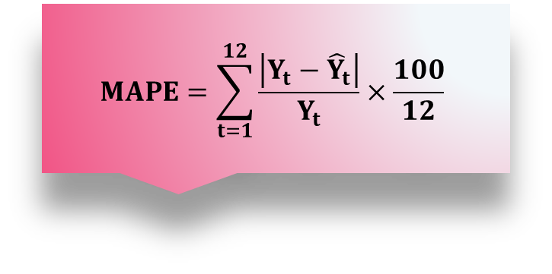
Accuracy Measurements
$$MAPE=\sum_{t=1}^{12}{\frac{\left|Y_{t}−{\hat{Y}}_{t}\right|}{Y_{t}}}×\frac{100}{12}$$
Model | MAPE Value | Forecasting Accuracy
SARIMA (1,1,0) (0,1,0)₁₂ | 4.076410436 | 95.92358956
SARIMA (0,1,1) (0,1,0)₁₂ | 3.881024454 | 96.11897555
SARIMA (1,0,1) (0,1,0)₁₂ | 2.893567068 | 97.10643293
Best Model
Accuracy=100-MAPE

Slide 38
Future Forecasts of Best Model:
Period 1961 Jan-Dec | Forecasted Values
Jan | 445.8506368
Feb | 420.0862959
Mar | 448.2887734
Apr | 490.4627413
May | 501.6122138
Jun | 564.7406401
Jul | 651.8509834
Aug | 635.9457901
Sep | 538.0272475
Oct | 491.0972355
Nov | 420.1573689
Dec | 462.2090353
SARIMA (1,0,1) (0,1,0)₁₂

Slide 39



Summery
Time Series Plot
Upward Trend
Seasonal Variation Of Lag 12
Best Model
Autocorrelation Function
Trend
Seasonal Pattern
$${\text{S}\text{ARIMA}\text{ (2,0,0) (0,1,0)}}_{\text{12}}$$
$${\text{SARIMA}\text{ (1,0,1) (0,1,0)}}_{\text{12}}$$
Tentative Model
SARIMA (1,1,0) (0,1,0)₁₂
$${\text{SARIMA}\text{ (1,1,1) (0,1,0)}}_{\text{12}}$$
SARIMA (0,1,1) (0,1,0)₁₂

Slide 40

Thank You

